Slide 1
IXIS Data Science challenge
Nicholas Picini

Slide 2
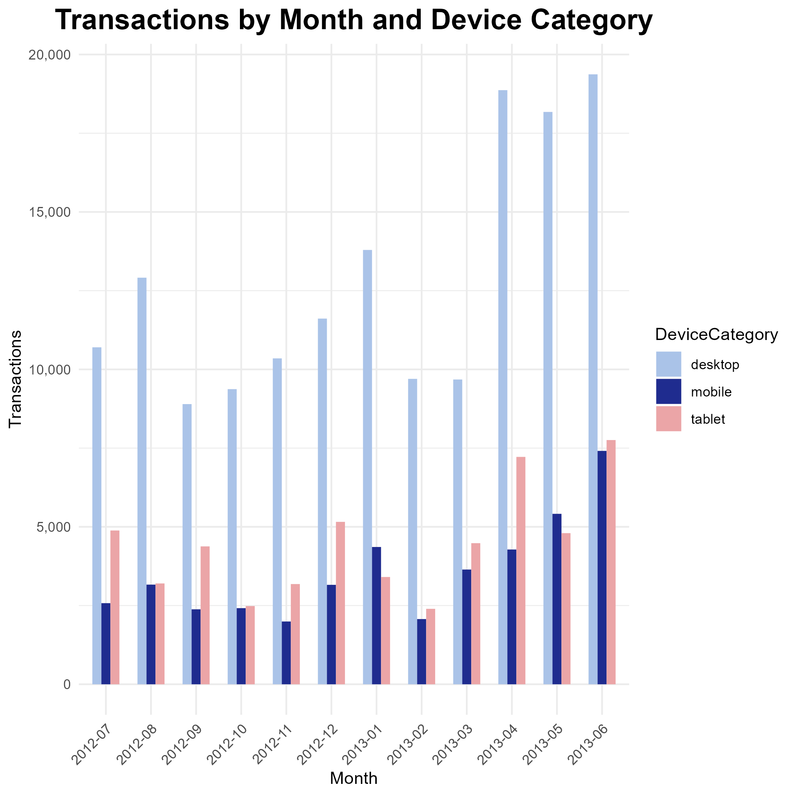
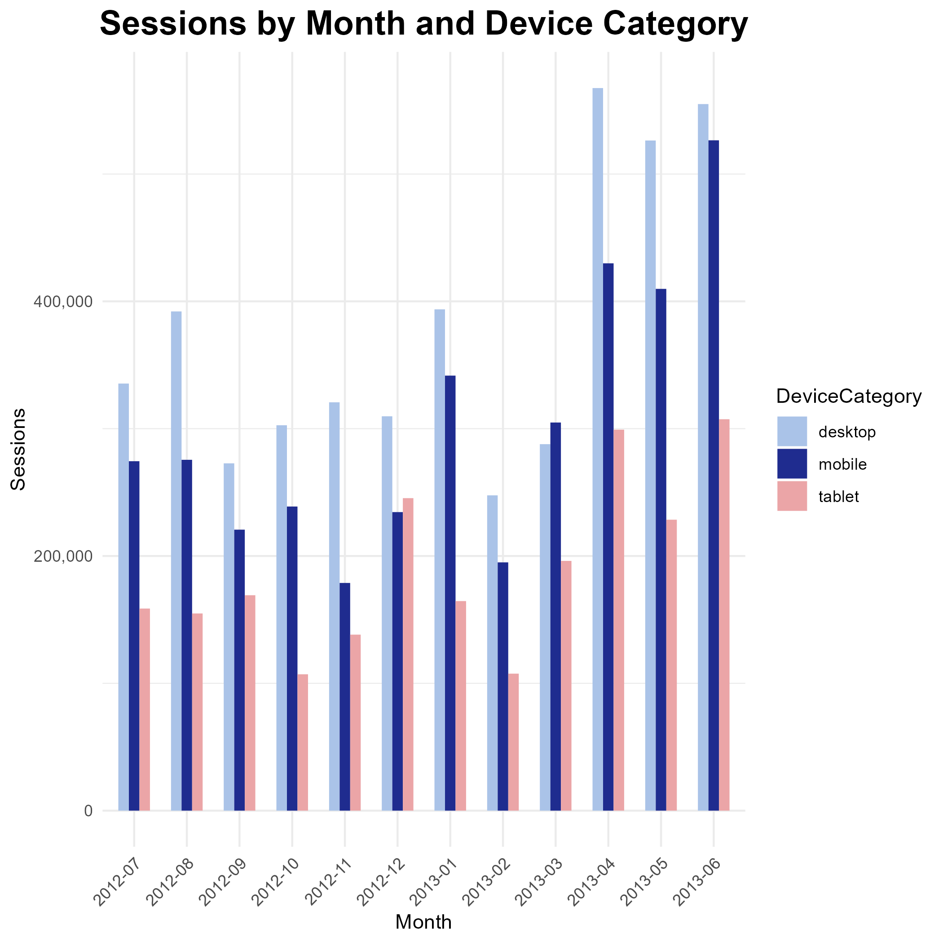
Website PERFORMANCE

Slide 3
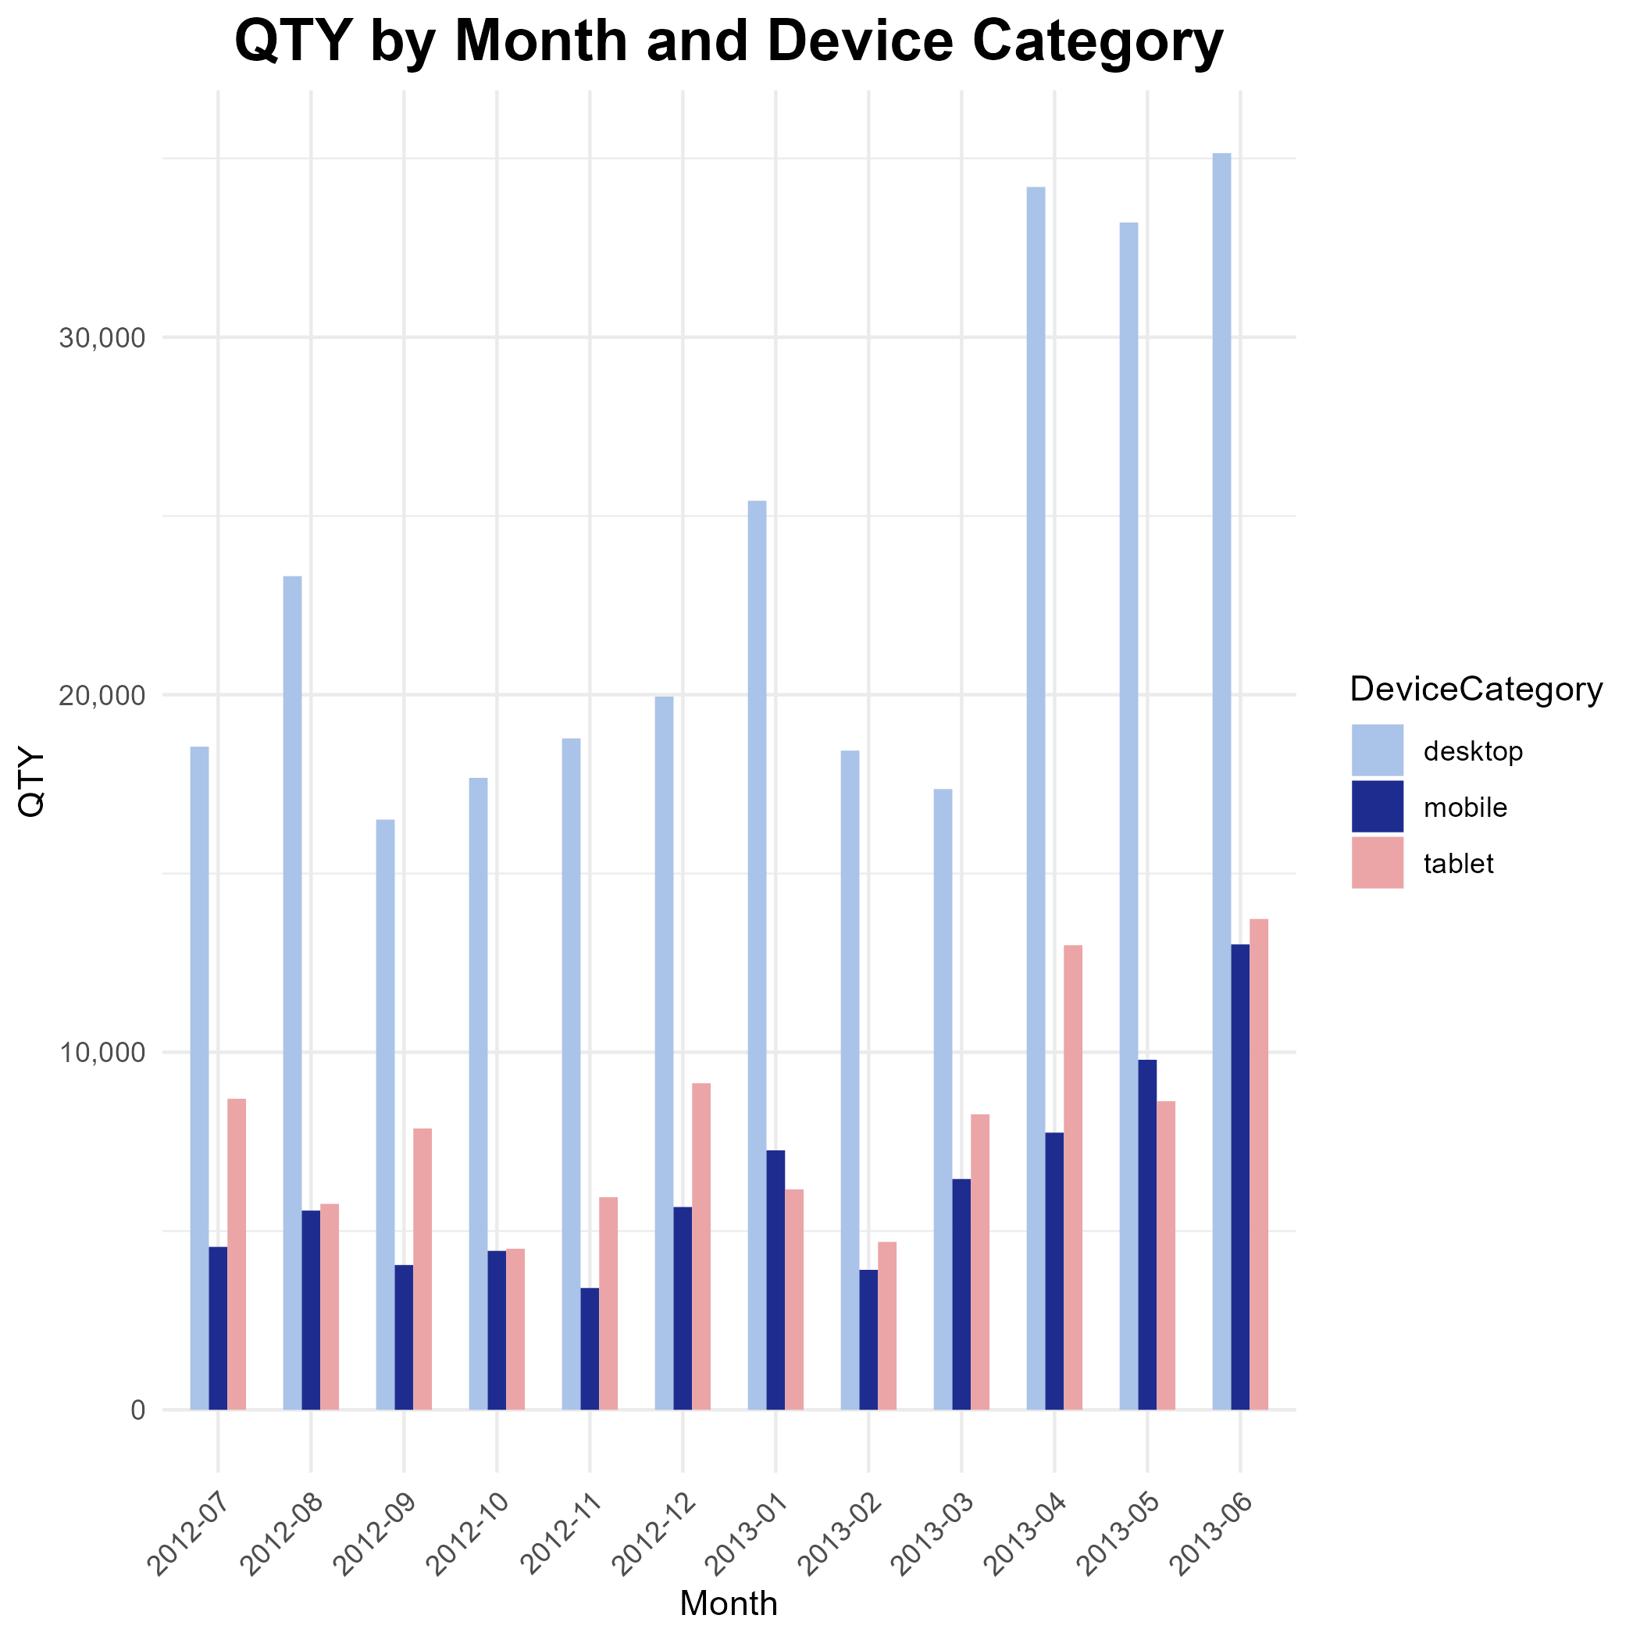
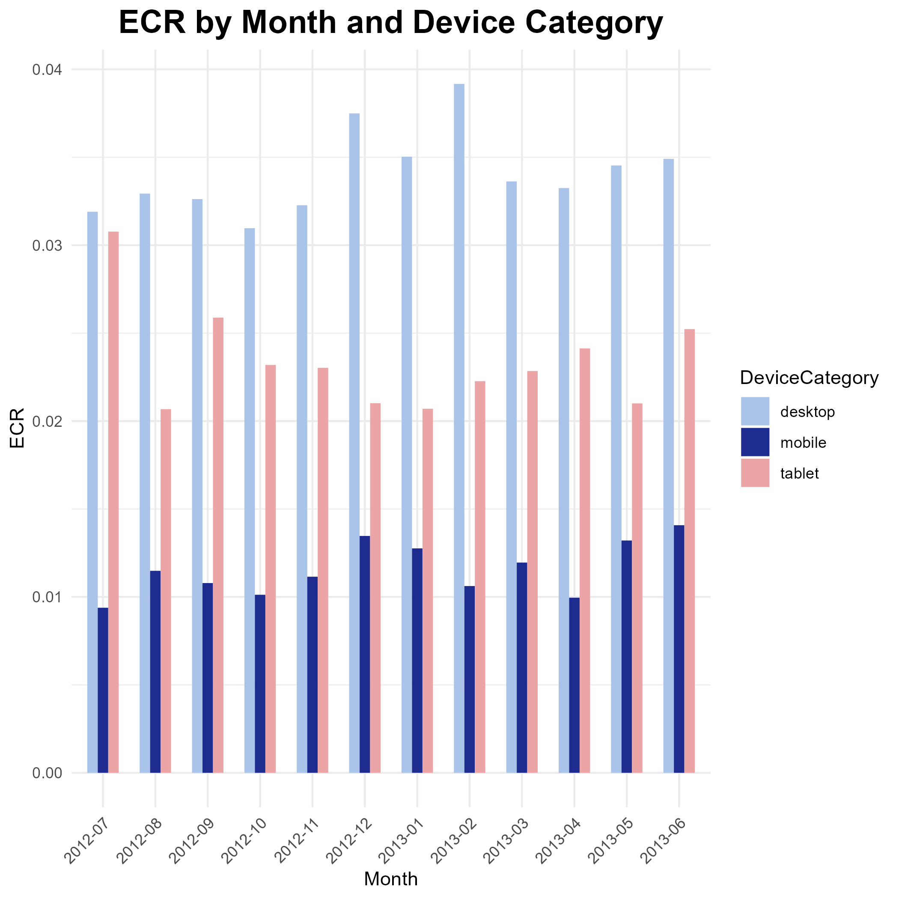
Website PERFORMANCE

Slide 4
Month over Month Comparison
Relative Difference M/M (Percentage)
Month | Relative Sessions | Relative Transactions | Relative QTY | Relative ECR | Relative AddsToCart
May 2013 | -10.72 | -6.74 | -6.22 | 3.99 | -29.40
June 2013 | 17.56 | 19.54 | 18.08 | 2.00 | -23.50
Absolute Difference M/M
Month | Absolute Sessions | Absolute Transactions | Absolute QTY | Absolute ECR | Absolute AddsToCart
May 2013 | 131974 | 1980 | 3317 | 0.00095 | 47122
June 2013 | 224195 | 6149 | 10262 | 0.00049 | 28750

Slide 5



Recommendations and Next Steps
From the data, it is clear users on desktop devices outperform both mobile and tablet users on all metrics. There is a clear seasonal trend in sessions, transactions, and QTY with fall/winter seeing lower levels and spring/summer seeing increased interest. Mobile users are the noticeable underperformers with tablet users close behind.
Targeting devices
Continual improvement
Outreach
Desktops outperform tablets and mobile on all metrics over past year
ECR for mobile users is very low; A/B test with targeted incentives
Optimize website features to enhance the mobile/tablet user experience and encourage conversions
Incorporate & monitor Customer Feedback at checkout to understand how users feel about overall experience
Implement targeted marketing campaigns for specific devices and/or off-peak months.
See which products sell best during different months
Explore partnerships or collaborations to expand reach and attract new customers on mobile and tablet end.
Product research for userbase of underperforming devices

